Slide 1

Era of bitcoins Since 2009
By:
180060010 - PRADEEP
180050101 - SURENDRA

Slide 2
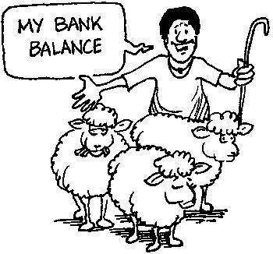
How it is used to be.. Around 70-years
Barter-System

Slide 3
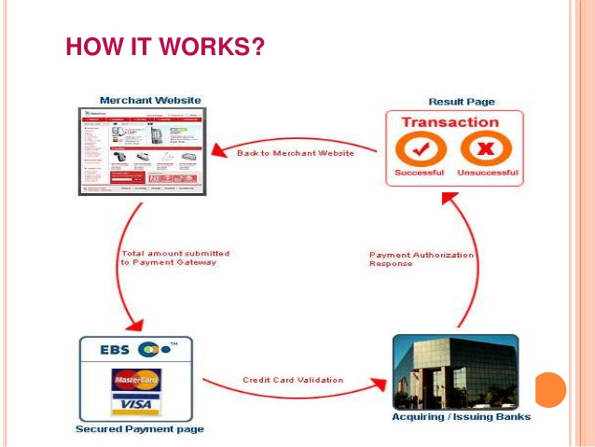
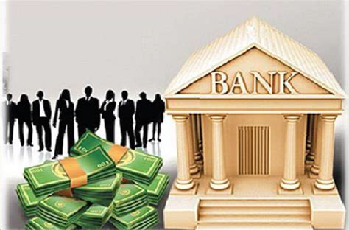

Slide 4
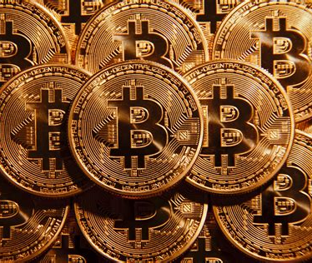
What are Bit coins??
Can we use them ?
What is the use of them ?
Is it Safe to use ?
How to create ?

Slide 5
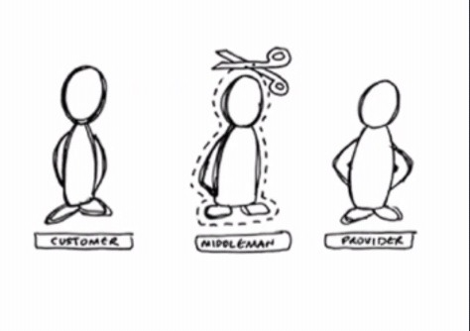
No Middle man intevention

Slide 6
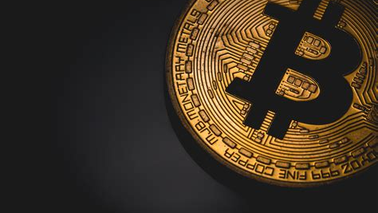
Started by Satoshi Nakamoto
In 2009, he came up with the digital coin also known BITCOIN
In-order to solve 2 major issues

Slide 7
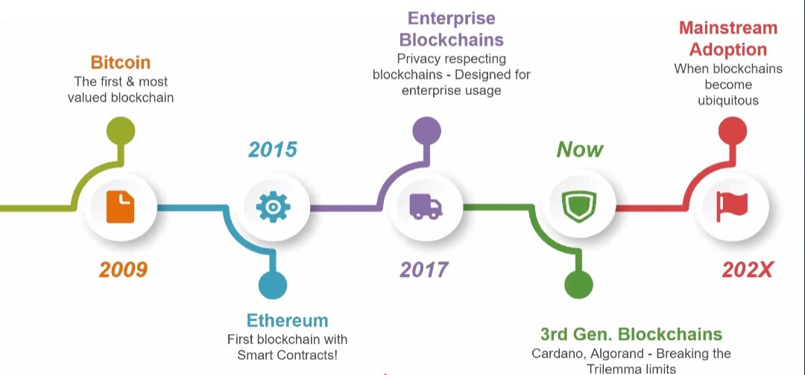

Slide 8

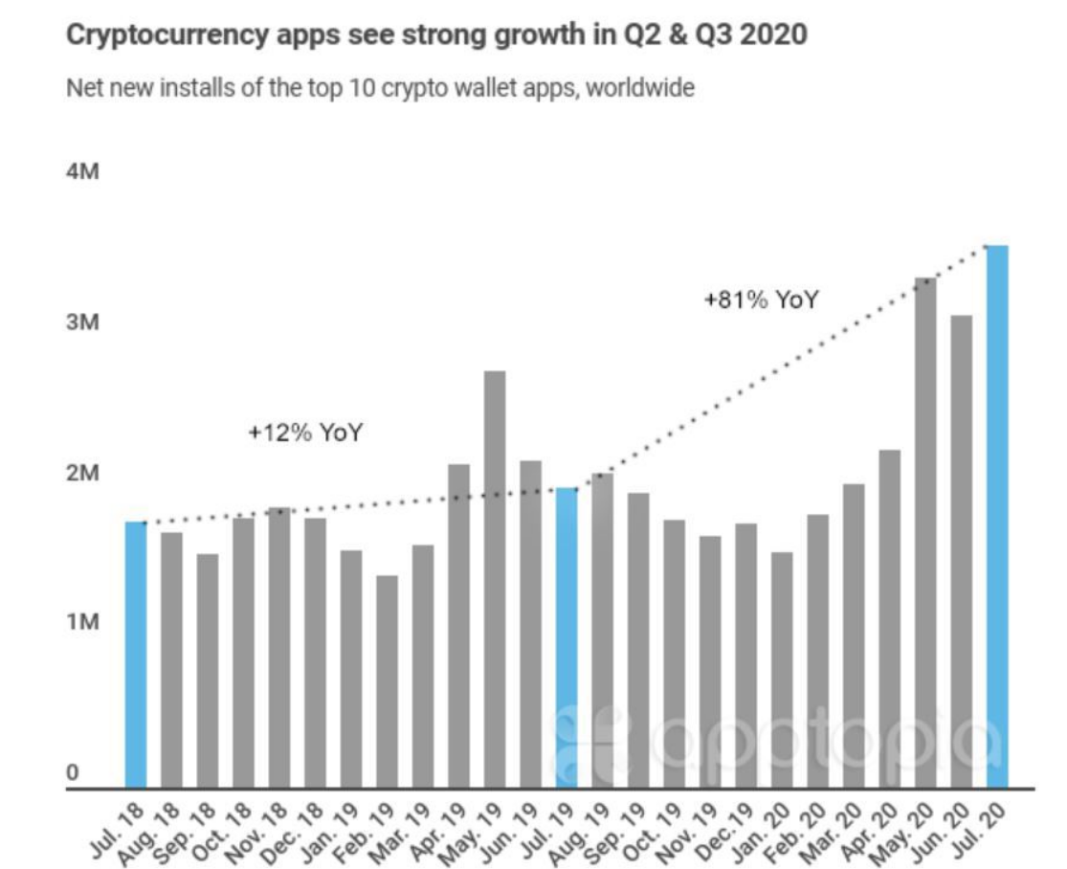

To free from TAX regulation & No middle Man force and Regulation free transactions

Slide 9

Crypto-currency
Now we Heard about BITCOIN similar terminologies like: BLOCKCHAIN, WALETS, Mining

Slide 10
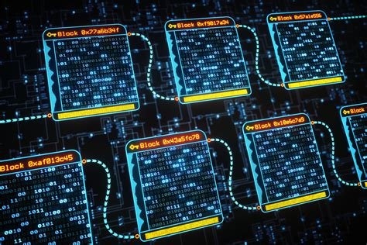
Block-chain

Slide 11
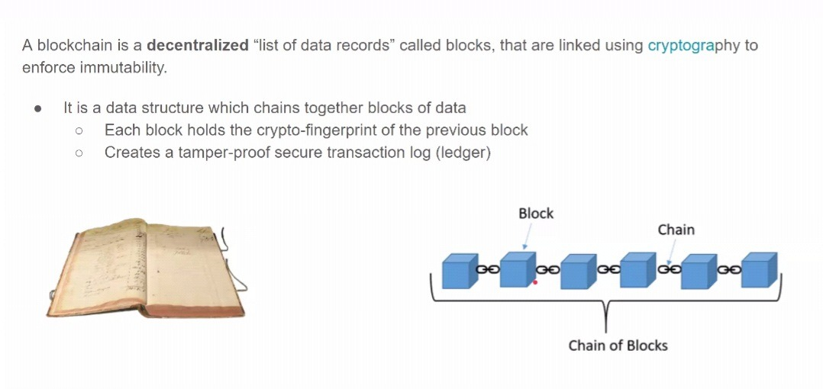
So what is Block chain ??

Slide 12
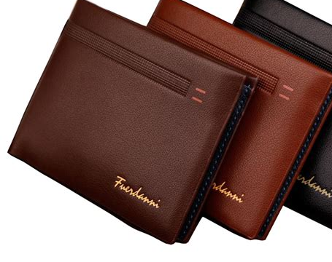
Generally we know these.. In the same way…

Slide 13
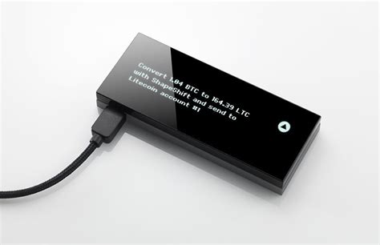
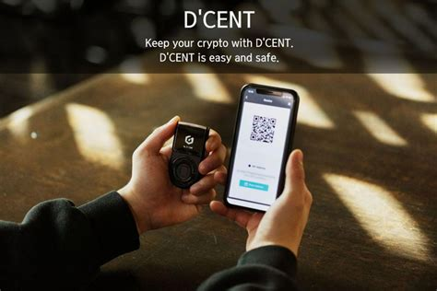
Crypto-Wallets
Today we have digital currency quite similar to that but far more different..

Slide 14
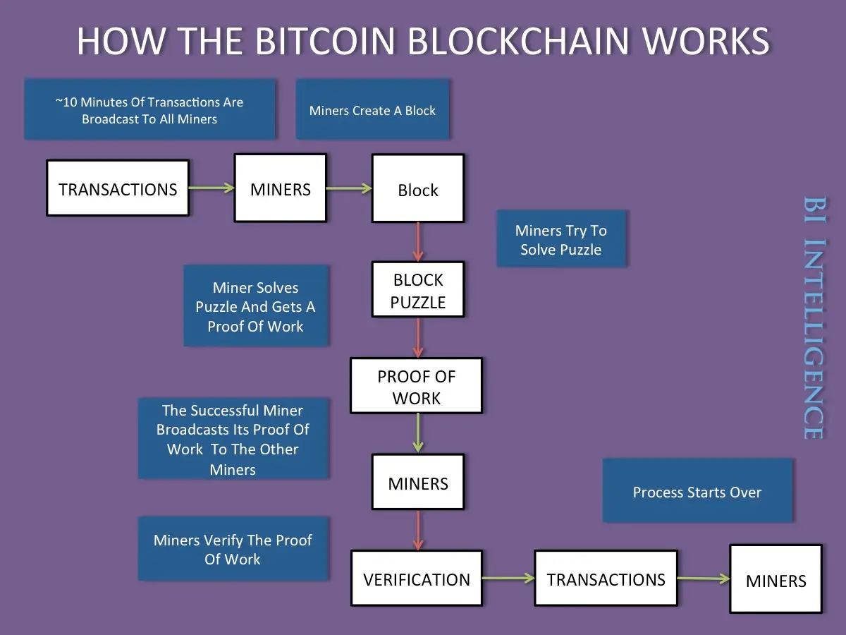

Slide 15
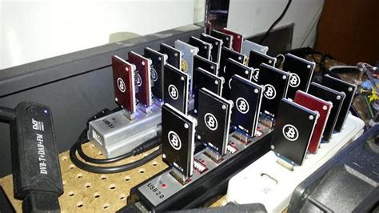
Bitcoin-Mining

Slide 16
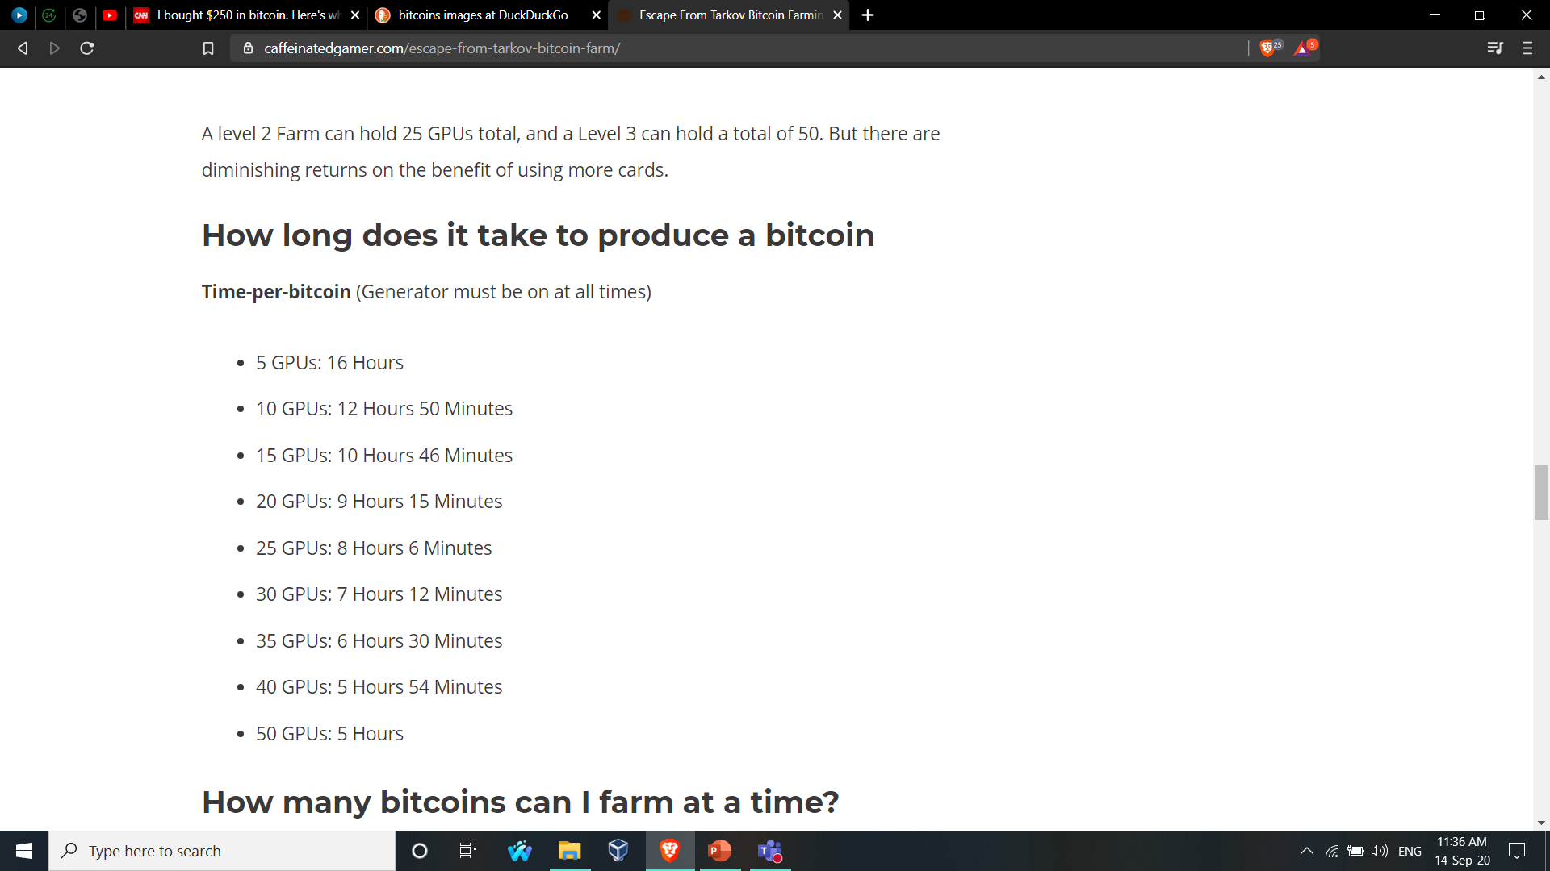
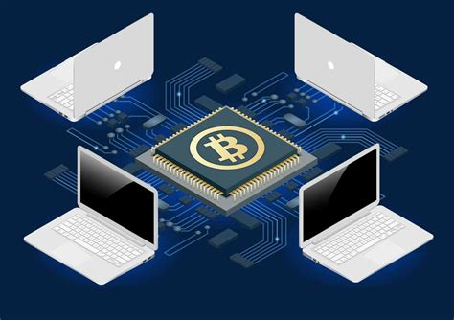

Slide 17
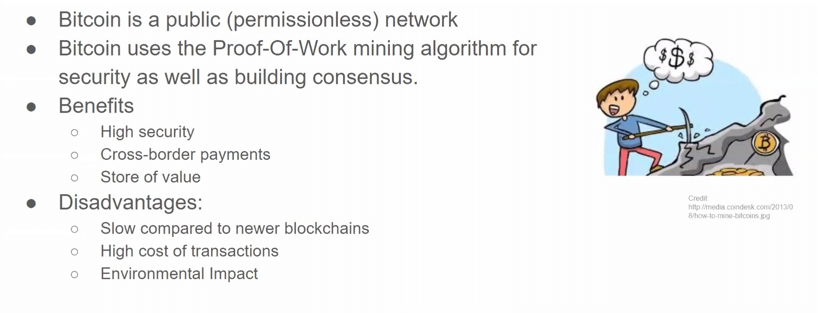

Slide 18
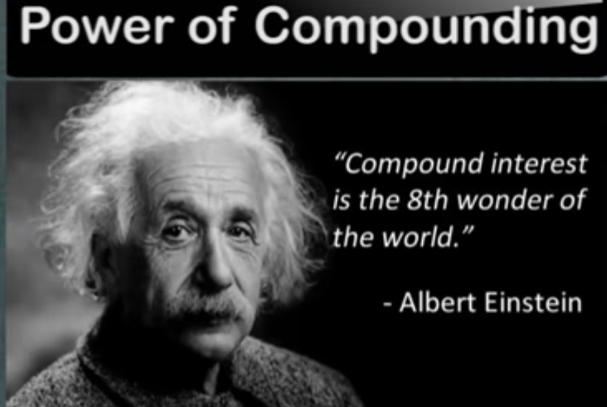

Slide 19
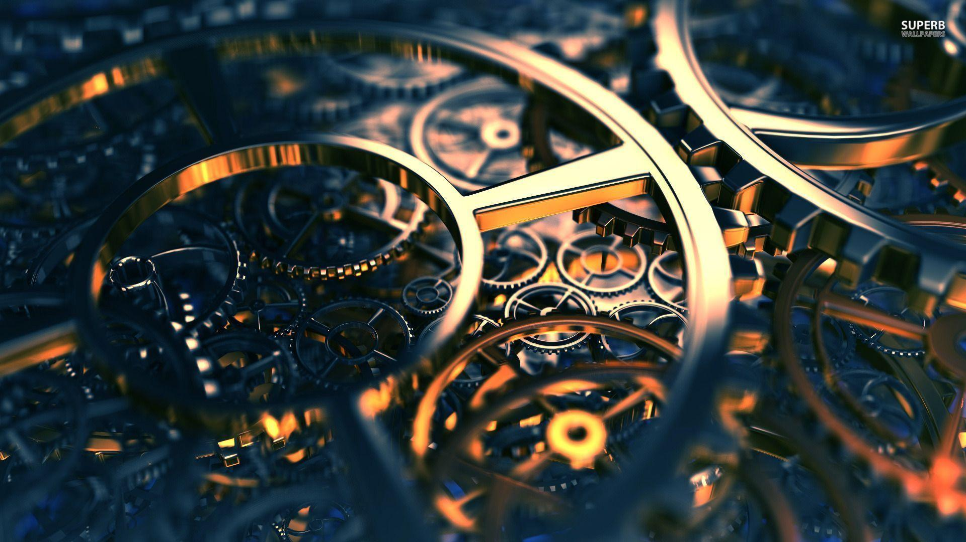
Thank you…
=> Choice of currency

